Slide 1
Information Security and Risk Management
Presented by:
Syed yawar Abbas Zaidi
11-10-2021

Slide 2
First Some Terms
First we have to discuss some terms we will use again and again
Protocol – an official set of steps or language for communication
Algorithm – a specific set of steps to solve a problem or do some task
String – a series of characters. Example if a character can be a-z and 0-9 an 8 character string might be “ar01z14b”

Slide 3

CIA

Slide 4
CIA… wrong CIA
CIA are the main 3 “objectives” of security

Slide 5
Confidentiality (53)
Protects the data from un-authorized disclosure
Ensures the necessary level of secrecy is enforced at each junction of data processing
confidentiality usually implements encryption
677d3edabfcd965da3ae4eb7f5e2f539

Slide 6
Integrity (52)
Ensuring that the data is not modified.
Must ensure accuracy and reliability of the information and Information Systems.
Must not allow unauthorized modification ( intentional or accidental*)

Slide 7
Integrity Example
“The trouble began Thursday morning, when Mizuho Securities tried to sell 610,000 shares at 1 yen (less than a penny) apiece of a job recruiting firm called J-Com Co., which was having its public debut on the exchange.
It had actually intended to sell 1 share at 610,000 yen ($5,041).
http://www.msnbc.msn.com/id/10394551/ns/business-world_business/t/botched-stock-trade-costs-japan-firm-m/#.Tj350YKZhBk

Slide 8
Integrity
Hashes and signed messages are examples of how to ensure integrity (we will talk about hashes and digital signatures in Chapter 4… don’t worry about them too much now)
Example
MD5: 164731747fc7236d799e588f60efbbe7

Slide 9
Availability (51)
The ability to access data and systems by authorized parties
This is very easy to attack and hard to defend against.
Attacks are often DoS type attacks.
Example of Availability attack:
Taking down a power grid
Stopping stock market trades

Slide 10
Security Management

Slide 11
Security Management
Now that we know the 3 principles of security lets talk about how we manage security.
Security Management is the creation, implementation and maintenance of an organizations security program.

Slide 12
Security Program
A Security Program is the methods a company uses to protect the companies assets
Any good security program should be “top down” with an ultimate goal. This approach management creates the vision and lays out the framework. It does not make sense just to run about locking down machines without a vision. Though this is often how things are actually done.*
A security program requires balanced application of Technical and non-technical methods!*
(more)

Slide 13
Security Program Development
A program is more than just a policy! It’s everything that protects data.
Security Program development is a LIFECYCLE!!!
Plan and organize
Implement
Operate and
maintain
Monitor and
Evaluate
Start over gain

Slide 14
Security Program
It includes and we will discuss
Risk Management
IS Policies, Procedures, Standards, Guidelines, Baselines
Information Classification
Security Education
Security Organization (Positions/Responsibilities)

Slide 15
Security Program Goals*
All security programs will have goals.. There are 3 main types of goals that you should be aware of
Operational goal – These are DAILY goals, very short term goals.
Example: installs security patch released today.
Tactical goals – mid term goals that help to achieve a final goal.
Example: create managed domain and move all workstations into the domain
Strategic Goals – long term objectives.
Example: Have all workstations in a domain with centralized security management, auditing, encrypted data access and PKI.

Slide 16
Business Requirements Private vs. Military
What security models and methods an organization uses depends on it’s goals and objectives.
Military is generally concerned with CONFIDENTIALITY
Private business is generally concerned with either availability (ex. Netflix, eBay etc) OR integrity (ex. Banks). Some private sector companies are concerned with confidentiality (ex. Drug companies)

Slide 17
Understand this
Management is ultimately responsible for security.
NOT administrators
NOT security professionals
Management is ultimately responsible
let me repeat… MANAGEMENT.
Management must lead and direct all security programs. They must provide the vision AND support*. Without their support a security program WILL fail. (a story perhaps?)

Slide 18
Lets REPEAT THOSE LAST CONCEPTS
Management is ultimately responsible for an organizations security

Slide 19
Information Risk Management

Slide 20
Information Risk Management (73)
IRM is the process of identifying and assessing risk and reducing it to an acceptable level*
There is no such thing as 100% security!*
You must identify risks and mitigate them with either countermeasure or by transferring risk.

Slide 21
Information Risk Management
Risk is impossible to totally measure, but we must prioritize the risks and attempt to address them!

Slide 22
What are risks*
Some types of risk
Physical Damage
Human Interaction (accidental or intentional action)
Equipment malfunction
Inside and Outsides attacks
Misuse of Data
Loss of Data
Application Error

Slide 23
Information Risk management
IRM is ultimately the responsibility of management *
All organizations should have an IRM policy.
The IRM policy should support the organizations mission.
All organizations should have an IRM team.
IRM should be a subset of the companies total Risk Management Policy.

Slide 24
IRM
Goal of IRM is to ensure the company is protected in the most cost effective manner!*

Slide 25
IRM team (75)
When creating an IRM Team
Remember goal is to keep things cost effective.
Therefore
Many companies will not have a large IRM team.
IRM team members usually have other full time jobs!
The team should not just consist of IT staff!
Senior Management Support is necessary for success*

Slide 26
Risk Management Terms! (54)
You need to know these terms we are about to cover on the next few slides
These terms are on pages 54. Memorize and internalize these terms! Read them again and again till you understand them..

Slide 27
Vulnerability* (54)
A software hardware or procedural weakness that may provide an attacker the opportunity to obtain unauthorized access.
Examples?
Could be an un-patched application
Open modems
Lax physical security
Weak network protocol

Slide 28
Threat * (54)
A natural or man-made event that could have some type of negative impact on the organization.
A threat requires a vulnerability to create an impact

Slide 29
Threat Agent (n/b)
An actual person or entity that takes advantage of a vulnerability.

Slide 30
Risk* (54)
This likelihood of a threat agent taking advantage of a vulnerability and the corresponding business impact
Risk ties the vulnerability, threat and likelihood of exploitation together.

Slide 31
Exposure (54)
An instance of being exposed to losses from a threat agent.
Example: A public web server that has a known vulnerability that is not patched, is an exposure.

Slide 32
Countermeasure or Safeguard* (54)
Some control or countermeasure put into place to mitigate the potential risk. A countermeasure reduces the possibility that a threat agent will be able to exploit a vulnerability.
You can NEVER 100% safeguard something*

Slide 33
Security Controls (49)
You try to protect your company with controls/counter measures/safe guards. These “controls” fall into one of 3 (or more) categories
Preventative
Detective
Corrective
(more)

Slide 34
Security Controls (49)
Each category can have controls of different types
Administrative – policies, standards, procedures, guidelines, personnel screening, training
Technical Controls (logical controls)* - authentication, firewalls, biometrics etc.
Physical Controls – locks, monitoring, mantraps, environmental controls.
(see next slide to see how these fit together)

Slide 35
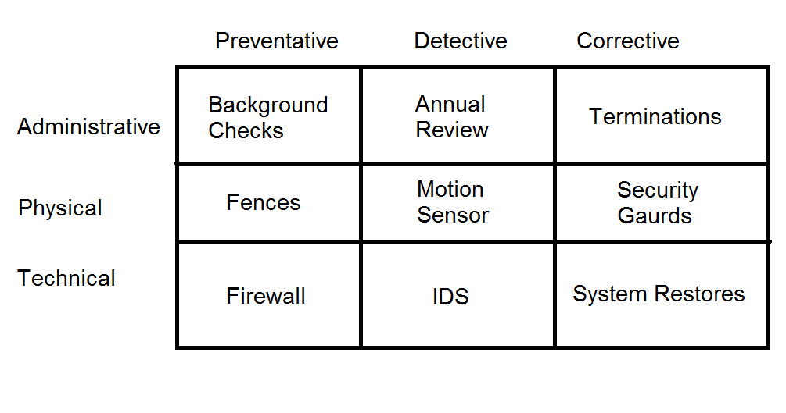
Control Matrix

Slide 36
Controls: Functional vs. Assurance
All controls must be evaluated by there functional and assurance requirements
Functional:
“Does the solution carry out the required tasks”*
Assurance:
“How sure are we of the level of protection this solution provides”*

Slide 37
Risk Analysis

Slide 38
Risk Analysis (76)
IRM team will need to analyze risk. But is risk analysis?
A tool for risk management, which identifies assets, vulnerabilities and threats.
Access possible damage and determine where to implement safeguards

Slide 39
Risk Analysis Goals (76)
Identify assets and their values
Identify Vulnerabilities and threats
Quantify the probability of damage and cost of damage
Implement cost effective countermeasures!*
ULTIMATE GOAL is to be cost effective.
What does that mean exactly?

Slide 40
Value of information and assets? (79)
It is important to understand an assets value if you plan on doing risk analysis. So what is something worth?
See pg 87 bullet items*
Note value can be measured both quantitatively and qualitatively*

Slide 41
2 types of analysis
Quantitative analysis
Qualitative analysis
Lets talk in detail about Qualitative vs. Quantitative specifically in the next couple slides

Slide 42
Quantitative (86)
Quantitative analysis attempts to assign real values to all elements of the risk analysis process. Including
Asset value
Safeguards' costs
Threat frequency
Probability of incident
(more)

Slide 43
Quantitative Analysis (86)
Purely quantitative risk analysis is impossible as there are always unknown values, and there are always “qualitative” values.
Examples?
You can automate quantitative analysis with software and tools. These require tons of data to be collected though, as such require along time and effort to complete.

Slide 44
Overview of steps in a quantitative analysis (87)
Assign value to an asset
Estimate potential loss for each asset and threat combination. (see SLE later)
Perform a threat analysis – determine the probability of each threat occurring.
Derive the Overall loss potential per threat per year.
Reduce, Transfer Avoid or Accept the Risk.

Slide 45
Steps in Quantitative Analysis (87)
Now lets’ break each step out more

Slide 46
Step 1:Assign value to assets (88)
What is something worth?
Cost to obtain
Money an asset brings in
Value to competitors
Cost to re-create
Legal liabilities
Etc…
At the end of step one we must be able to assign a value to each asset.

Slide 47
Step 2:Estimate Loss Potential* (88)
For each asset/vulnerability combination we need how much an instance of damage would cost us.
Physical damage
Loss of productivity
Cost of repairing
The expected percentage of damage of the total asset value is called the Exposure Factor (EF)*

Slide 48
Step 2:Estimate Loss Potential* (88)
The expected percentage of damage of the total asset value is called the Exposure Factor (EF)*
Example:
If you have a warehouse with $1,000,000 of value, and the threat is a fires, your fire suppression systems might stop a fire at 25%, this is your EF.

Slide 49
Step 2: 2:Estimate Loss Potential*
Once we have the EF we use it to determine the Single Loss Expectancy (SLE) of an incident.
SLE= asset value * EF

Slide 50
Step 2: 2:Estimate Loss Potential*
In the warehouse / fire example
SLE= asset value * EF
asset value was $1,000,000
EF was 25% (.25)
SLE= $1,000,000 * .25
SLE= $250,000

Slide 51
Step 3:Perform a Threat Analysis (88)
Figure out the likely hood of an incident.
Analyze vulnerabilities and rate of exploits.
Analyze probabilities of natural disasters to your location
Review old records of incidents.
In this step we need to calculate the Annualized Rate of Occurrence (ARO)*
Example: chance of a fire in any month=10% then the ARO = .10 * 12 (1 year) So we can expect an ARO=1.2

Slide 52
Step 4: Derive the ALE (88)
Derive the Annual Loss Expectancy
ALE = SLE * ARO
Example:
The ALE for the warehouse fire is
ALE=SLE * ARO
SLE = $250,000
ARO = 1.2
ALE = $250,000 * 1.2
ALE = $300,000
Be able to do these calculation for the exam

Slide 53
Step 5: Reduce, Transfer, Avoid or Accept the Risk (88)
For each risk you can do the following
Reduce risk*
Install countermeasures to reduce ARO or EF
Transfer Risk*
Accept Risk*
Avoid Risk*

Slide 54
Determining Cost Effective Countermeasures (95)
When determining whether to implement an countermeasure, you MUST be concerned about being cost effective.

Slide 55
Determining Cost Effective Countermeasures (95)
Here how we determine whether a countermeasure is cost effective

Slide 56
Determining Cost Effective Countermeasures (95)
Compute the ALE without the countermeasure in question
Compute ALE2 which is the ALE after installing the countermeasure
Add the cost of the countermeasure to ALE2
Compare ALE to ALE2
If ALE > ALE2 then the countermeasure is cost effective

Slide 57
Word Problem
Details:
The probability of a virus infection per month is 50%.
If an outbreak occurred your sales staff of 5, would not be able to work for the 4 hours while the systems were rebuilt. Each sales person makes $40/hour.
IT would require 1 person 4 hours to repair at a cost of $50/hour.
A certain antivirus system could stop ALL viruses (ok, that’s just to make the math easier) but the cost is 20K per year for this system.
Questions:
Should you implement the Anti-virus system?
If so how much are you saving?
If not how much are you wasting by buying it?

Slide 58
Word Problem Answer
Step 1: Determine SLE
(5 sales * 4 hours each * $40) + (1 IT * 4 hours * 50) = $1000 cost per incident
Step 2: Determine ARO
ARO = 12 months * .50 likelihood per month= 6
Step 3: Determine ALE
ALE = SLE ($1000) * ARO (6) =
ALE = $6000.00

Slide 59
Word Problem Answer
ALE without countermeasure was determined to be $6000
Compute ALE2
ALE2 (ALE after countermeasure) = $0.00
Countermeasure cost = $20,000
ALE2 + countermeasure cost = ($0) + $20,000.00
ALE2 = $20,000
Which is smaller?
ALE ($6,000) or ALE2 ($20,000)

Slide 60
Word Problem Answer
In this case it is NOT cost effective to implement the countermeasure.

Slide 61
Details of Reducing Risk (95)
If the cost per year of the countermeasure is more than the ALE, don’t implement it, instead either:
Transfer the risk
Avoid the risk
Accept the risk

Slide 62
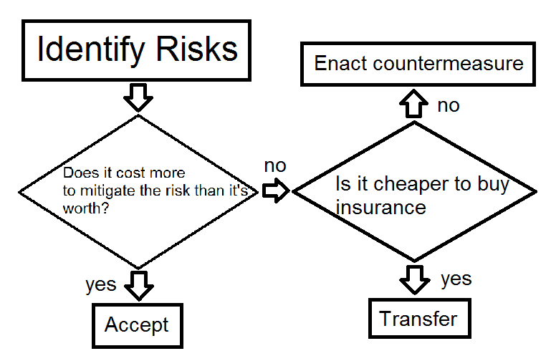
Risk Analysis Flowchart

Slide 63
Total Risk vs. Residual Risk (100)
No matter what controls you place to protect an asset, it will never be 100% secure. The leftover risk after applying countermeasures is called the residual risk.*
Total Risk is the risk a company faces if they choose accept the risk.
(more)

Slide 64
Total Risk vs. Residual Risk (100)
A control gap* is the protection a countermeasure cannot provide
Conceptual (not actual) formulas*
Threats x vulnerabilities x asset value = total risk
(threats, vulnerabilities, asset value = total risk
(threats x vuln x asset value) x control gap = residual risk
Total risk – countermeasures = residual risk

Slide 65
Review of Quantitative (91)
Assign value to assets
Estimate potential loss per asset/threat (SLE)
Estimate likelihood of threat (ARO)
Estimate Annual Loss per year (ALE)
Examine available countermeasures and compute the new ALE + countermeasure cost (ALE2) after each is applied
Determine whether to reduce, transfer, avoid or accept Risk

Slide 66
Qualitative Risk Analysis (91)
Rather than assign values to everything uses subjective methods to analyze risk and determined methods of managing the risk.
Techniques includes
Judgment
Best practices
Intuition
Experience

Slide 67
Qualitative* (91)
Specific techniques we will discuss include
Delphi
Brainstorming
Focus groups
Surveys
Questionnaires
Interviews and one-on-one meetings

Slide 68
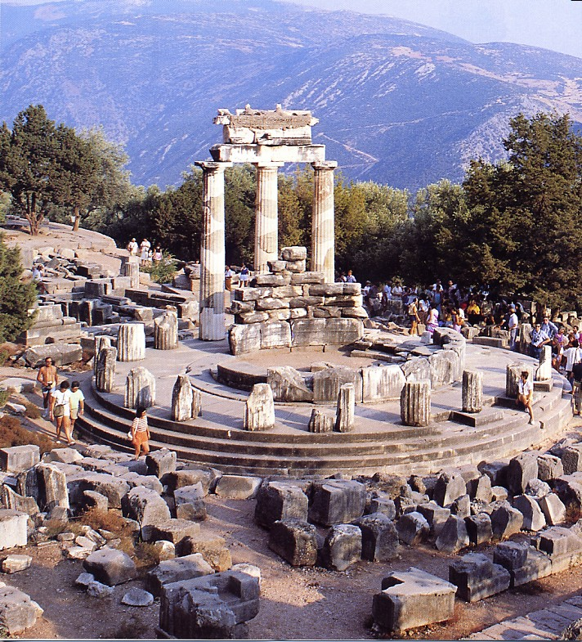
Delphi

Slide 69
Delphi* (94)
Technique where a groups comes together, each member gives an honest opinion of what he or she believes the result of a threat will be.
Idea is to have everyone express their true ideas and not just go along with one person dictates
The results are then compiles and given to group members that ANONYMOUSLY write down there comments and returned to analysis group.
These comments are compiled and redistributed for comments until a consensus is reached

Slide 70
Modified Delphi (94)
A silent form of brainstorming , participants develop idea individually without a group and submit their ideas to decision makers.

Slide 71
Other Qualitative Methods
Brainstorming -
a conference technique of solving specific problems, amassing information, stimulating creative thinking, developing new ideas, etc., by unrestrained and spontaneous participation in discussion.
http://dictionary.reference.com/browse/brainstorming

Slide 72
Other Qualitative Methods
Focus groups –
a representative group of people questioned together about their opinions on political issues, consumer products, etc.
http://dictionary.reference.com/browse/focus+group

Slide 73
Other Qualitative Methods
Surveys
Questionnaires
Interviews and one-on-one meetings

Slide 74
Review of Quantitative and Qualitative (95)
Read over chart on 95 – internalize for exam
Qualitative Cons
Subjective
No dollar values
No standards
Quantitative cons
Complex calculations
Extremely difficult without tools
Lots of preliminary work required

Slide 75
Policies, Standards, Baselines, Guidelines, and Procedures

Slide 76
Policies Standards, Baselines, Guidelines and Procedures (102)
A security program must have all the pieces necessary to provide overall protection to a company and lay out a long term strategy. Policies, Standards, Baselines, Guidelines and Procedures are part of the security program
You NEED to understand the terms in the following slides for the exam. (Polices, standards, baseline, guidelines and procedures)

Slide 77
Security Policy* (102)
An overall GENERAL statement provided by senior management.
Very generic
Provides “missions statement for security”
Should represent business objectives
Should be easily understood
It should be developed at integrate security into ALL business functions and processes*
(more)

Slide 78
Security Policy (102)
It should be reviewed an modified as a company changes.
Policy should be dated and version controlled.
It should be forward thinking
It should use strong language (MUST, not should)
Should be non-technical

Slide 79
Security Policy
Can be one of four types
Regulatory – ensures an organization is following required regulations (finance, health)
Advisory – strongly advises employees as to which types of behaviors should/should not take place
Informative – informs employees of goals and missions relevant to a company, not specific or enforceable
Directive

Slide 80
System Specific Security Policy
An organization security policy needs to be technology and solution independent.. it outlines the goals and missions.. NOT specific ways of accomplishing them.
A systems specific policy represents the managements decision on SPECIFIC technologies and situations. These outline for example password policies or data encryption policies. These system specific polices are the structure that provides the support for the organizational security policy.

Slide 81
Standards* (106)
Standards are MANDATORY* actions or rules.
Defines compulsory* rules.
Standards give a policy it’s support and start adding specifics.
Example:
a standard is “all employees MUST wear their company ID badge at all times”

Slide 82
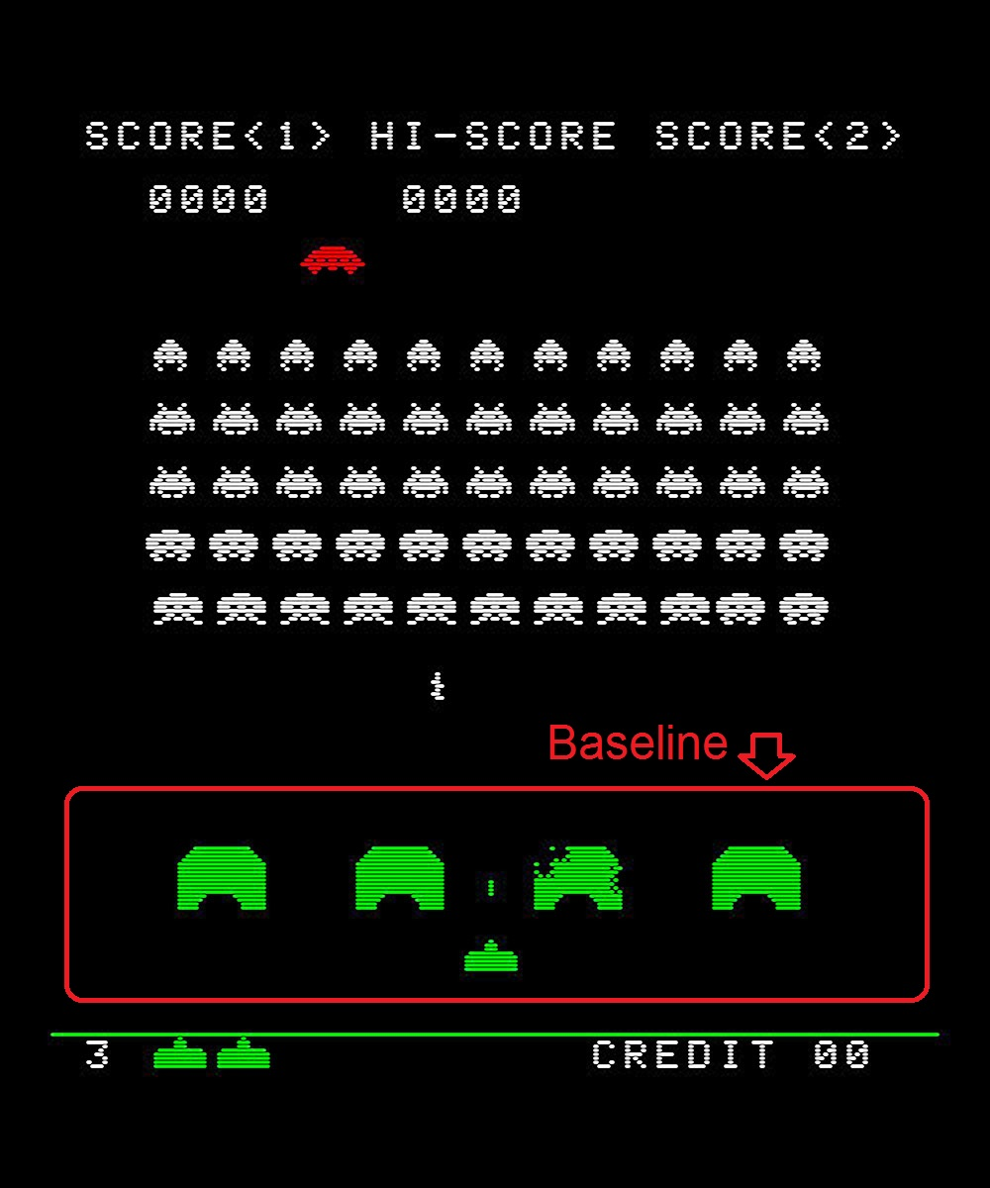
Baseline
The row of shields above your fighter that protects you from attack by hordes of aliens

Slide 83
Close actually…
Baselines – the process of establishing a minimum set of protections for a computer system/network in order to protect it attack from the hordes of script-kiddies and crackers.
MINIMUM set of protections and configurations

Slide 84
Baseline* (107)
Example: a baseline my require that a system be compliant to some external measurement. Any systems must meet these requirements, changes to the system must be assessed to ensure the baseline is still being met.
(more)

Slide 85
Baseline (107)
A baseline may also be a technical definition or configuration of a system.
Examples:
a baseline my specify that all windows XP systems must have SP2 installed, and ISS turned off.
a baseline may also specify all Linux systems run SElinux in enforcing mode.

Slide 86
Baseline (107)
Why are baselines important?

Slide 87
Guidelines* (108)
Guidelines are RECOMMENDED actions.
These cover the gray areas and are approaches to provide flexibility for unforeseen things.
The are not specific rules, but best practices.
Can someone provide an example of a guideline?

Slide 88
Procedures* (108)
Detailed step-by-step tasks that should be performed in some situation.
Lowest level In the policy as they are closest to users and resources.
Procedures spell out how policy, standards and guidelines will be implemented for a specific resources (ex. OS)
Example:
written procedures on OS installation and configuration.

Slide 89
Random Terminology* (110)
You need to understand the following 2 terms for the exam
Due Diligence*: act of investigating and understanding a risk a company faces.
Due Care*: demonstrates that a company has taken responsibility for it’s activities and has taken necessary steps to protect it’s assets and employees from threats.
Not practicing these can lead to charges of negligence.

Slide 90
Random Terminology* (110)
You need to understand the following 2 terms for the exam
Due Diligence*: act of investigating and understanding a risk a company faces.
Due Care*: demonstrates that a company has taken responsibility for it’s activities and has taken necessary steps to protect it’s assets and employees from threats.
Not practicing these can lead to charges of negligence.

Slide 91
Review of Policies, Standards…
We just talked about Polices, Standards, Baselines, Guidelines and Procedures
Internalize these terms for the exam

Slide 92
Information Classification

Slide 93
Information Classification (111)
We need to be able to assign value to information, this is Information Classification.
Data is classified to ensure data is protected in a COST-EFFECTIVE* manner.
Each classification should have separate handing requirements.

Slide 94
Information Classification
Military vs. private sector concerns
Military is usually more concerned with confidentiality
Private Sector is usually more concerned with integrity and availability

Slide 95
What are some common classifications?
Let’s look in the book at page 113.
You should know these levels and what are example of each level for the exam!

Slide 96
Classification Controls (115)
Once data is classified we must take measures in order to protect and manage the data
Access controls
Encryption of data in transit* and at rest*
Data access should be logged and audited
Periodically review classifications
Backup and restoration procedures
Change Control procedures
Proper data disposals

Slide 97
Positions and Responsibilities

Slide 98
Positions and Responsibilities
Senior management is obviously ULTIMATELY responsible for data security, risk management and pretty much everything else. However let’s look at some of the other positions commonly found and see what their responsibilities are.
For the exam, you should know all the positions we are about to talk about*

Slide 99
Data Owner* (125)
Data owner is usually a member of management who is in charge of a specific business unit and responsible for that information that such a unit possesses.
Responsible for specifying the classification of data
Responsible for determining necessary controls are in place to protect data
(more)

Slide 100
Data Owner*
This is a “Business” role
Classifying data or authorizing data access requests
Defining backup requirements (not implementing)
Ensuring security controls are appropriate (not implementing)
Delegates day-to-day maintenance to the “data custodian”
Act on security violation notifications

Slide 101

Data Custodian

Slide 102
Data Custodian* (125)
The Data Custodian MAINTAINS the data day to day.
Performs backups
Ensures the availability of data.
Validates data integrity
Restores data
Ensures data retention requirements based on what the data owner specifies

Slide 103
Security Administrator* (126)
Setup security configurations on a system as defined by the DATA OWNER*
Creates accounts
Sets access rights in support of the policies defined.
Technical position.

Slide 104
Understand this (security administrator)
A security administrators jobs is to ensure the managements directives are fulfilled! They do NOT create security policies*
They also do NOT authorize access to data or resources. They are responsible for ensuring the security controls enforce the access levels that have been specified by the data owner or the management’s policies.

Slide 105
Security Analyst* (127)
Helps define a security program elements and ensures the elements are being implemented properly by the technical people and procedures.
This is NOT an implementation role
Higher more strategic level.

Slide 106
Supervisor (127)
More of an HR role, you all know what a supervisor does.
Managing employees
Ensuring employees live up to their responsibilities
Handle HR tasks such as hiring, firing and initiating corrective action.
Informing security admin of changes to an employees position.

Slide 107
Data Analyst (128)
Ensures hat data is stored in a way that makes the most sense for it’s application.
Specifically considered with information “architecture”, how data is stored in reference to other data, data structures
Work with data owners to ensure the structures support the business objectives.

Slide 108
Process Owner (128)
Are responsible for certain business processes (not computer processes ;)
Examples:
Procurement process
Hiring process
Order fulfillment process

Slide 109
User * (128)
Someone who uses the data, day to day to accomplish work tasks and business objectives
Responsible for following data and security procedures that have been laid out by management.

Slide 110
Auditor* (129)
Provides a method for independently ensuring that management and shareholders can rely upon the appropriateness of security objectives.
Determines if controls/methods have been reached
Determines if practices are in compliance with company or legal requirements
Should be 3rd party

Slide 111
Auditor (not in book)
The exam might also refer to an auditor in the role of someone in the company that goes though security, or usage logs to determine if data and technical systems are being used/abused/attacked etc.
This is the form/usage I remember from the exam.

Slide 112
Administrative Controls and Concepts

Slide 113
Separation of Duties*
The idea of ensuring one individual cannot complete a critical task by themselves.
Reduces the possibility for fraud, sabotages, theft or general abuse.
To subvert separation of duties requires collusion* (next page)

Slide 114
Collusion* (133)
At least two people working together to subvert the security controls.

Slide 115
Hiring Practices* (131)
All employees should have background checks and be screened* (even janitors etc in high security environments)
Everyone MUST sign an NDA, which should protect secrets and conflicts of interest.
Drugs tests
Education checks
Reference checks

Slide 116
Rotation of Duties* (133)
Employees should rotate in their duties
Why?
For redundancy
To ensure no-one has too much control over a segment of business

Slide 117

Mandatory Vacations

Slide 118
Mandatory Vacations* (133)
Employees MUST take vacations
Why?
Gives opportunity for others to discover fraud. If employees don’t want to take a vacation, they might be doing something underhanded and do not want to be found out
Additionally it enforces that other people can step in and that the process cannot be disrupted by that employee being absent for whatever reason.

Slide 119
Split Knowledge* (133)
Separation of duties concept. An employee only has enough knowledge to perform part of a task.
Again helps fight fraud.
Example:
Two managers only know their half of a bank vault combination.

Slide 120
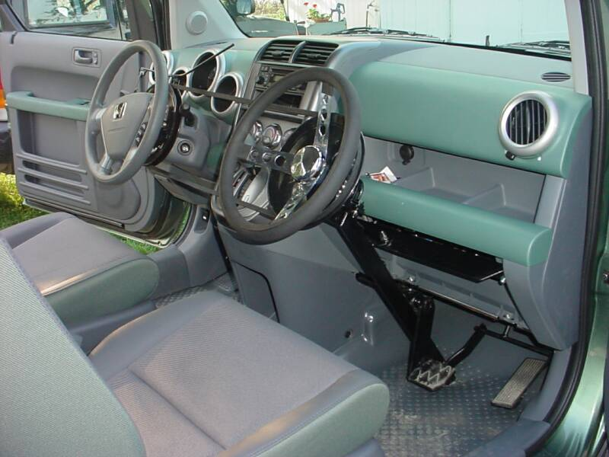
Dual Control

Slide 121
Dual Control (133)
Like split knowledge, but in this case two or more people must be available and active to perform an action.
Example:
A bank vault has two separate keys that must be turned at the same time to unlock the vault.

Slide 122

Employee Termination

Slide 123
Employee Termination* (133)
Companies should have a defined procedure for employee termination, it must be strictly enforced.
Examples policy could be:
Employee must complete an exit interview
Employee must surrender id badges, and keys
Employee accounts must be locked out.
Employee must leave the facility immediately under supervision of a security guard

Slide 124
Security Awareness Training
Any security program MUST provide adequate thought and resources to training.
Security is only as good as the weakest link.
Unless your staff is trained on the importance of security, proper security procedures and concepts, and day to day security operations… you are doomed to fail.
The most expensive and technical controls will be rendered useless by uneducated staff.
Some security threats (etc phishing) can only properly be mitigated by user education

Slide 125
Chapter 3 - Review
Q. What is a vulnerability
Q. What is an SLE
Q. If a warehouse has a value of $1,000,000 and an EF in case of a fire is 30%. What is my SLE?
Q. Who is ultimately responsible for a companies security?

Slide 126
Chapter 3 - Review
Q. Can 100% quantitative risk analysis be done? Why or why not?
Q. What is the Delphi technique?
Q. Which of the following is not a method to deal with risk
avoidance
transference
Acceptance
obfuscation
Q. What is the primary security purpose of mandatory vacations?

Slide 127
Chapter 3 - Review
Q. who classifies data?
Q. Should a companies security policy statement include specific technical details on encryption of data in transit?
Q. What is the ultimate consideration in choosing a safe guard?
The safe guard is ______ ______.
Q. What are the 3 principals of security?

Slide 128
What Can I Teach?

